Slide 1

Reformer
The Efficient Transformer
Nikita Kitaev, Łukasz Kaiser, Anselm Levskaya
Published as a conference paper at ICLR 2020
Presentation by:
Nadira Ahmadi and Hanan Al Hujaily
11/01/2024

Slide 2
Outlines:
1. Overview of the Reformer
2. Reversible Layers
3. Complexity in Attention
4. LSH Attention
5. Experiments and Results
1
Efficient and faster Transformer alternative
2
Memory-Efficient training in Reformer
3
O(L^2) to O(L) Enhancing efficiency on long sequences
4
Locality Sensitive Hashing
Results
5

Slide 3
Overview of the Reformer
Improvement in Memory Efficiency, Trade-off speed
Take advantages of sparsity of attention to attend to longer sequences
Reversible Layers (as in RevNets)
Approximate attention based on LSH nearest-neighbors
1

Slide 4
Reversible Layers
Avoid having to store activations in each layer.
Normal residual layer performs a function that operates in single input and produce a single output.
x y that has the form y = x + F(x)
Reversible layer works on pairs of inputs and outputs:
(x1,x2) (y1,y2)
Applying RevNet idea to Transformer by combining attention and feed-forward layers inside the revnet block.
Y1 = X1 + Attention (X2)
Y2 = X2 + FeedForward (Y1)
2

Slide 5
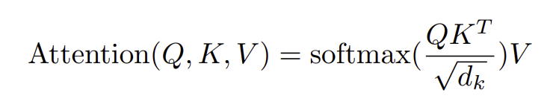
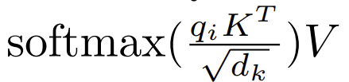
Complexity in Attention
Standard Attention used in Transformer:
Memory-efficient Attention:
3

Slide 6

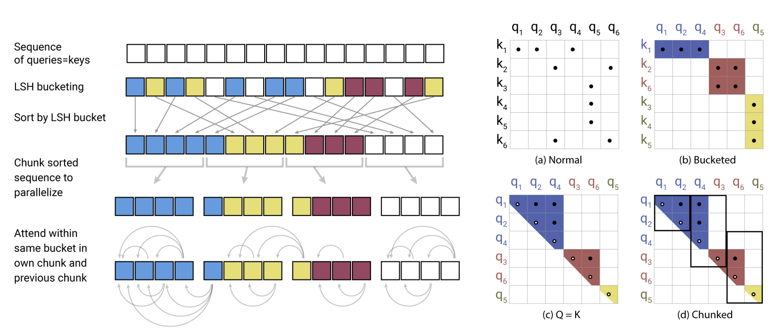
LSH Attention
Normal Attention for single query position i at a time:
LSH Attention function:
4

Slide 7
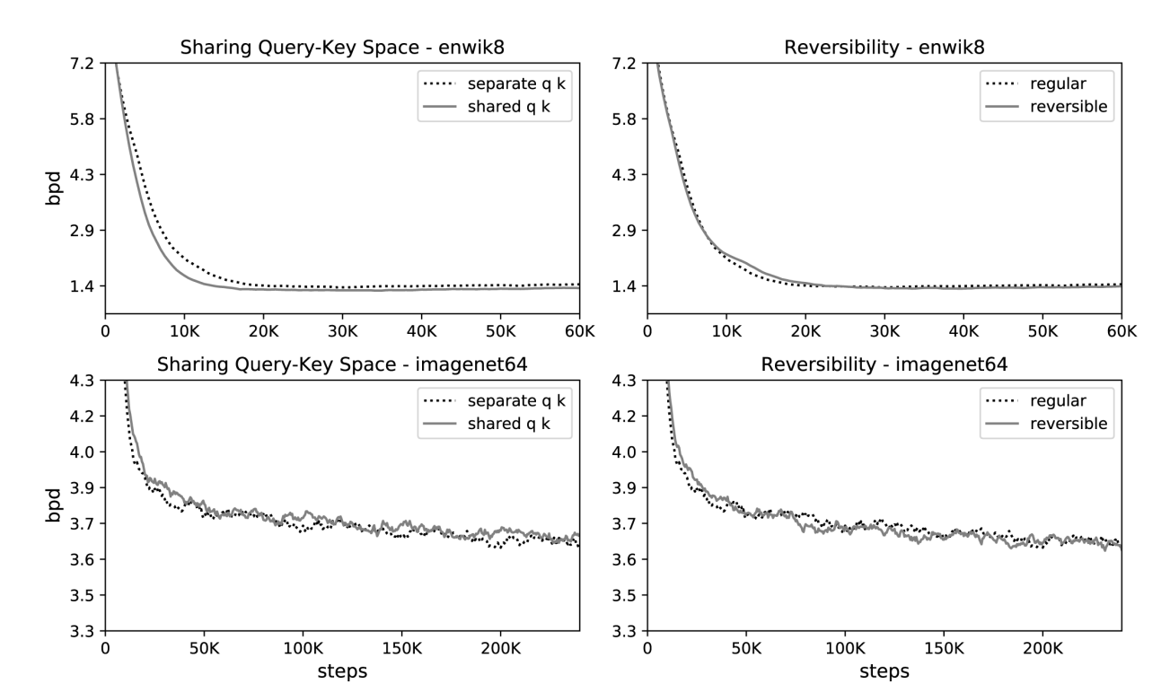
Experiments and Results
Effect of shared query-key space and reversibility on performance on enwik8 and imagenet64 training.
5

Slide 8
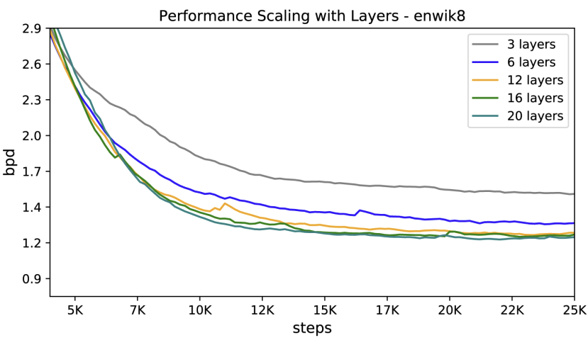
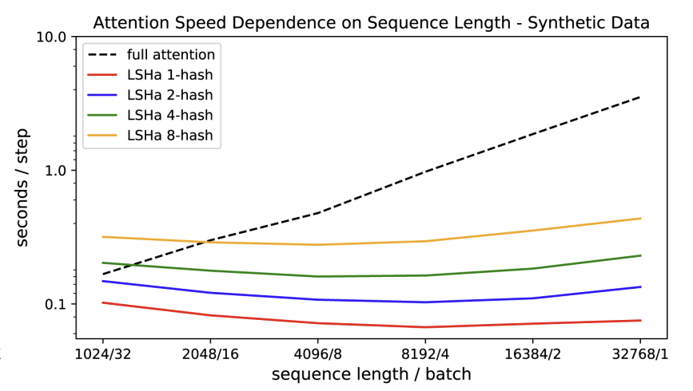
Experiments and Results
6

Slide 9
Conclusion
Reformer combines the modelling capacity of a Transformer with an architecture that can be executed efficiently on long sequences and with small memory use even for models with large number of layers.
7

Slide 10

END

